Slide 1
Search Result Diversification in Resource Selection for Federated Search
Date： 2014/06/17
Author ： Dzung Hong , Luo Si
Source： SIGIR’13
Advisor: Jia-ling Koh
Speaker： Sz-Han,Wang

Slide 2
Outline
Introduction
Approach
Experiments
Conclusion

Slide 3
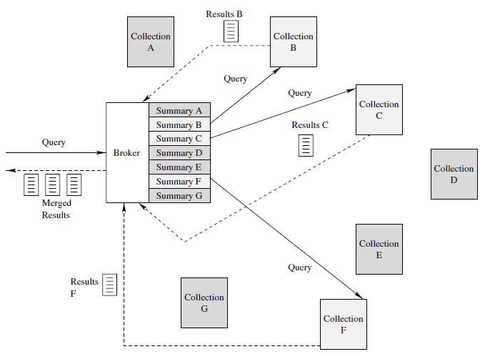
Introduction
Federated Search
Query:
螢幕翻轉相機

Slide 4
Introduction
Three major sub-problem
Resource representation
Resource selection
Result merging integrate
Resource selection
Little is known about selecting a set of sources that balances relevance and novelty.

Slide 5
Introduction
Ambiguous and multifaceted queries
EX: “Jaguar” -> animal or car model
EX: “Batman”-> a name of movie , a comic character , or the comic itself
Goal
Proposes new approach in diversifying result of resource selection in federated search.

Slide 6
Outline
Introduction
Approach
Experiments
Conclusion

Slide 7
Approach
Two approches for diversification in resource selection
Diversification approach based on sample Documents(DivD)
Diversification approach based on Source-level estimation(DivS)
A classification approach combining diversification results
LR-Divs
Diversification metrics in resource selection for federdated search
R-based diversification metric

Slide 8
Diversification approach based on sample Documents(DivD)
Goal
Reduce the contribution of a document that may be relevant to the query, but offers less novelty in the overall ranking
Based on existing Resource selection algorithms
Relevant Document Distribution Estimation (ReDDE)
Central-rank-based (CRCS)
Combine existing diversification algorithm
PM-2

Slide 9
Relevant Document Distribution Estimation
All source and document:
source 1: a1,a2,a3…a50
source 2: b1,b2,b3…b150
source 3: c1,c2,c3…c100
1. Initialize score of all source
source1 | source2 | source3
0 | 0 | 0
2. Estimate the probability of relevance given a document
source1 | source2 | source3
2 | 4 | 3
3. Estimate the number of document relevant to query
Ranked list of all source:
source2、source3、source1
Return the ranked list of all sources based on their scores

Slide 10
Diversification approach based on sample Documents
All source and document:
source 1: a1,a2,a3…a50
source 2: b1,b2,b3…b150
source 3: c1,c2,c3…c100
Centralized sample database:
a1,a3,a7,a10,a13,b5,b9,b25,b30,b47,
c1,c9,c56,c88,c99
1. Initialize score of all source
source1 | source2 | source3
0 | 0 | 0
2. Rank documents of centralized sample database by an effective retrieval algorithm
Rerank documents of centralized sample database
a1,b5,b9,b25,c88,c1,c9,b47,a7,c56,
a13,a10,c99,b30,a3
Rank documents of centralized sample database
a1,b5,b9,b25,c88,a7,c56,b47,c1,c9,
a3,c99,a13,a10,b30
Rank documents of centralized sample database
a1,b5,b9,b25,c88,a7,c56,b47,c1,c9,
a3,c99,a13,a10,b30
3. Rerank that list by existing diversification algorithm
source1 | source2 | source3
2 | 4 | 3
4. For each document on top of the ranked list do {Add the constant score c to source}
Return the ranked list of all sources based on their scores
Ranked list of all source:
source2、source3、source1

Slide 11
Diversification approach based on Source-level estimation
Goal
Proposes another diversification approach for resource selection that operates at the source level
Based on existing Resource selection algorithms
Relevant Document Distribution Estimation (ReDDE)
Central-rank-based (CRCS)
Big Document (Indri)
CORI
Combine existing diversification algorithm
PM-2

Slide 12
Diversification approach based on Source-level estimation
1. Rank all sources using standard ReDDE
Ranked list of all source:
source2、source3、source1
2. Estimate P(sj | qi) ,the probability of relevance of source sj with respect to qi
Query aspect | source1 | source2 | source3
aspect 1 | 0.3 | 0.8 | 0.9
aspect 2 | 0.7 | 0.2 | 0.1
5. Rerank the list obtained in step1 by using PM-2 algorithm with the estimated P(sj | qi) as input
6. Return the ranked list of all sources based on their diversification
Ranked list of all source:
source2、source1、source3

Slide 13
LR-Divs
Utilize the source score information from the resource selection algorithms as features:
ReDDE.top、CRCS、Big Document、CORI
Relevance probability of source Si given$f_{i}^{j}$ by a sigmoid function σ:
Learning the combination weight w
$S_{i}^{j}$ : the binary variable that indicates the relevance of the i-th source to the query q_{j}
($S_{i}^{j}$ =1 indicates relevance, and $S_{i}^{j}$ =0 indicates otherwise)
$f_{i}^{j}$ : the vector of all features returned by the resource selection algorithms

Slide 14
R-based diversification metric
Based on the popular R-metric for resource selection in federated search
Ei : the number of relevant documents of the i-th source
according to the ranking E by a particular resource
selection algorithm.
Bi : the same quantity with respect to the optimal ranking B.
 | Ei | Bi
source1 | 3 | 5
source2 | 2 | 3
source3 | 4 | 6
R3=$\frac{3+2+4}{5+3+6}\text{=}\frac{9}{14}$

Slide 15
R-based diversification metric
R-based diversification metric
S : the set of selected sources for comparison
M : a diversity metric of a ranked list of documents
(ex: ERR-IA, α-nDCG, Prec-IA, S-Recall and NRBP)
 | α-nDCG(S) | α-nDCG(all source)
Set 1 | 0.4 | 0.5
Set 2 | 0 | 0.3
Set 3 | 0.3 | 0.6
Set 4 | 0.4 | 0.5
Set 5 | 0 | 0.2
RM(S)=$\frac{0.4}{0.6}\text{=}\frac{2}{3}$

Slide 16
Outline
Introduction
Approach
Experiments
Conclusion

Slide 17
Experiments
Dataset
Testbed based on Clueweb English
Centralized sample database
300 documents have been sampled from each source
Diversification Algorithm
Based on PM-2
Aspect: subtopics、suggestions
Baseline
ReDDE.top
CRCS

Slide 18
Experiments
Diversification versus Standard Resource Selection Algorithms

Slide 19
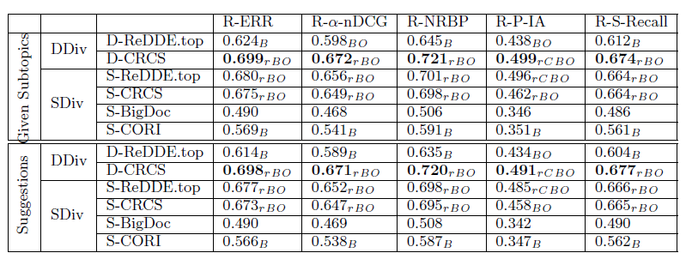
Experiments
Diversification with Different Resource Selection Algorithms

Slide 20
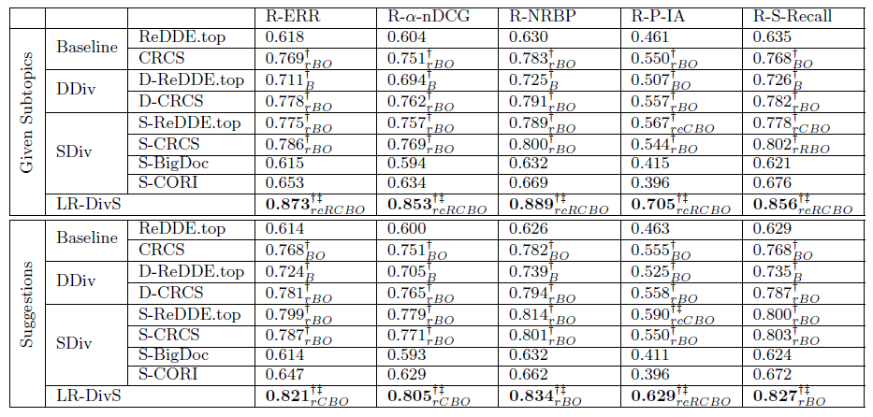
Experiments
Classification Approach for Combining Diversification Results

Slide 21
Outline
Introduction
Approach
Experiments
Conclusion

Slide 22
Conclusion
Proposes the first piece of research for incorporating search result diversification in resource selection for federated search.
A learning based classification approach is proposed to combine multiple resource selection algorithms for more accurate diversification results.
A family of new evaluation metrics is first proposed for measuring search result diversification in resource selection.
Both the approach based on sample documents and on source-level estimation can outperform traditional resource selection algorithms in result diversification.

